Slide 1


Project 1 SDR FM Receiver
By 高荣 曹正阳

Slide 2
Content
Introduction
Result and Analysis
Experiences

Slide 3
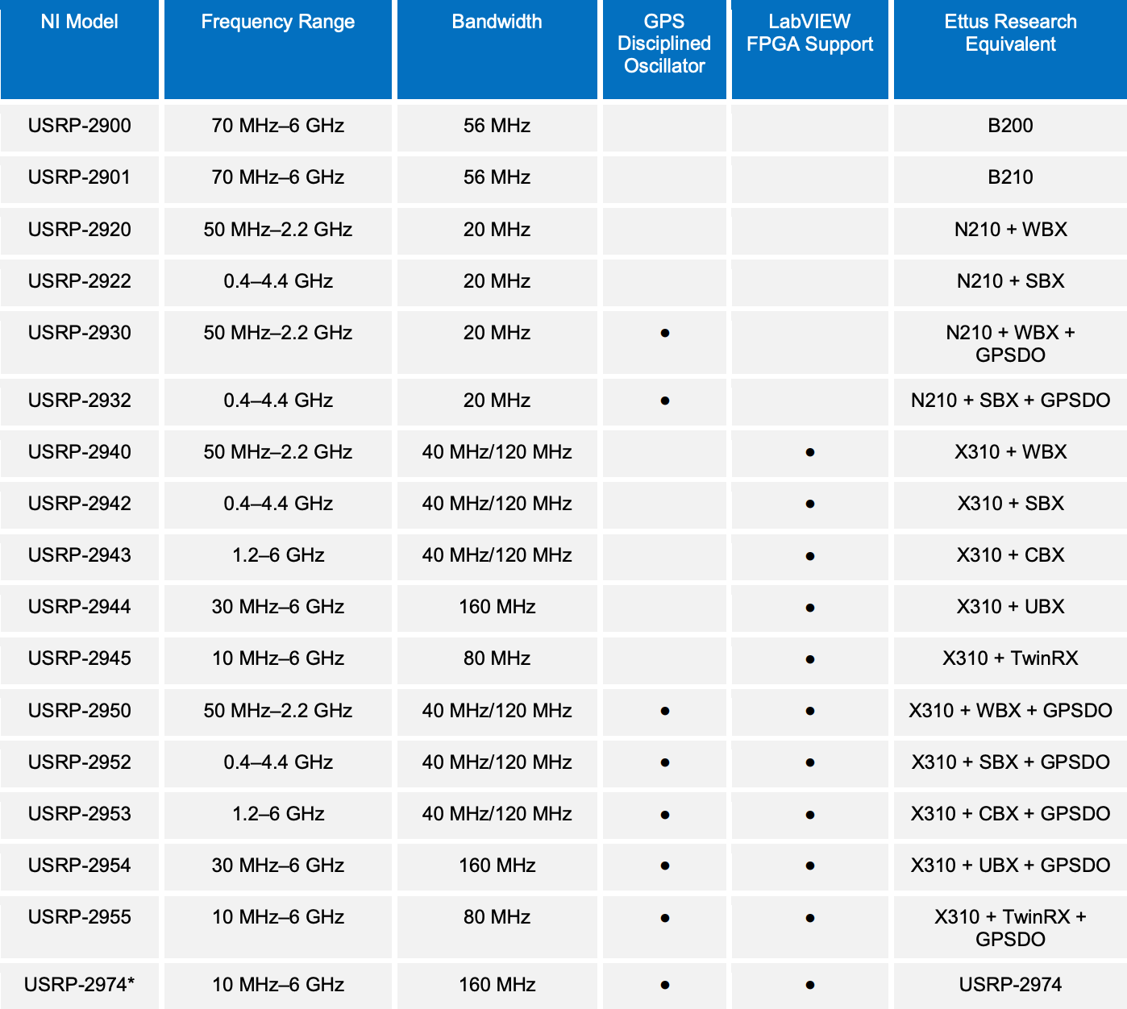
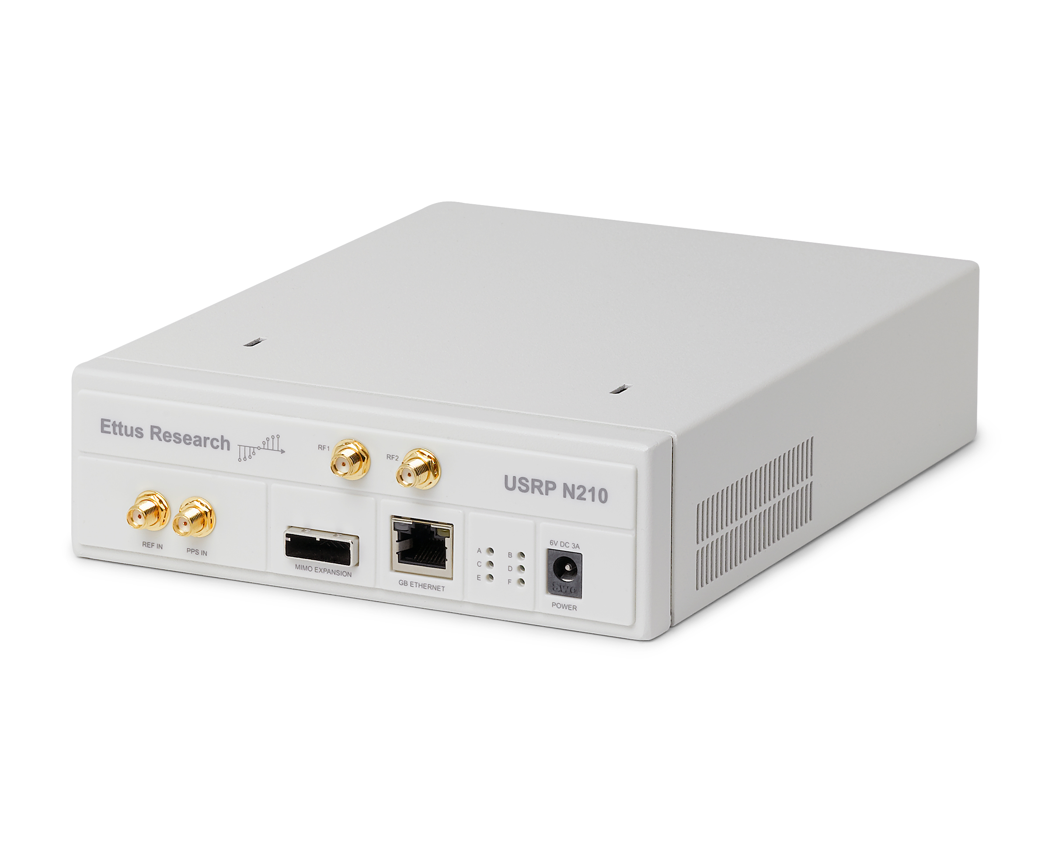
Intro
ettus.com/all-products/un210-kit/
www.ni.com/pdf/product-flyers/usrp-software-defined-radio.pdf

Slide 4
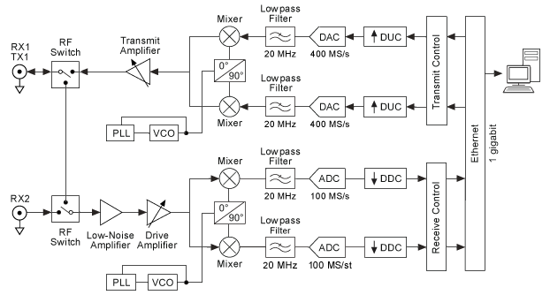
USRP原理
researchgate.net/figure/Hardware-structure-of-the-USRP-device_fig18_308277394

Slide 5

USRP原理

Slide 6







FM原理
Complex baseband
相位展开
反正切法

Slide 7
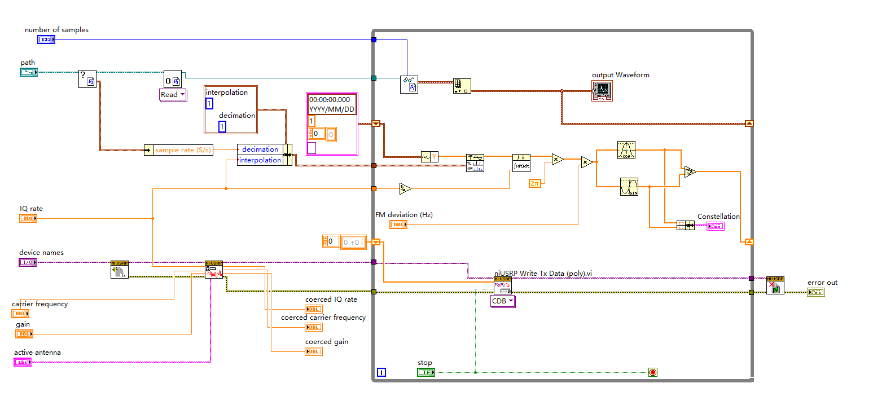
Music test

Slide 8
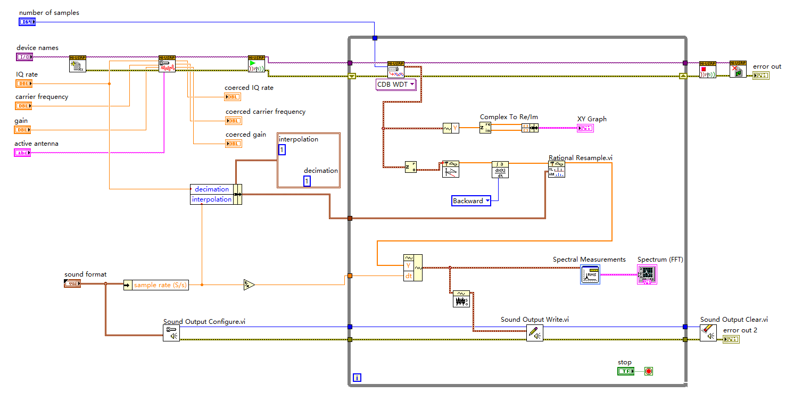
Music test

Slide 9
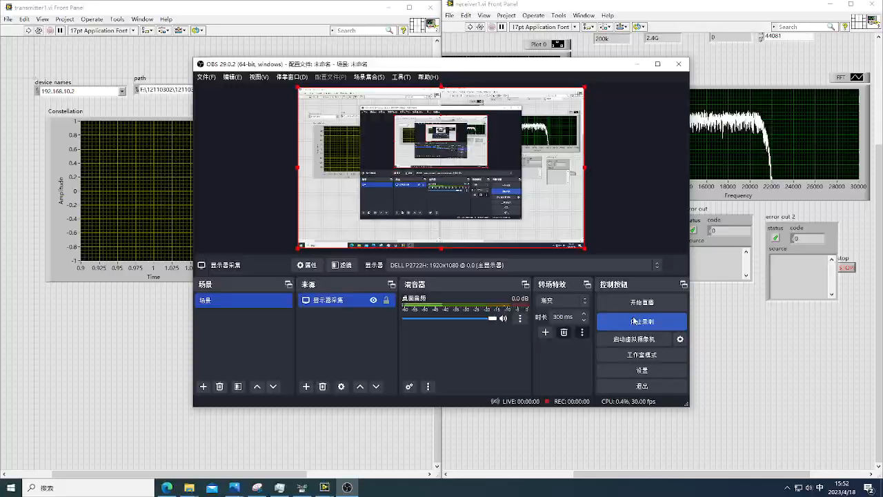
Music test result

Slide 10
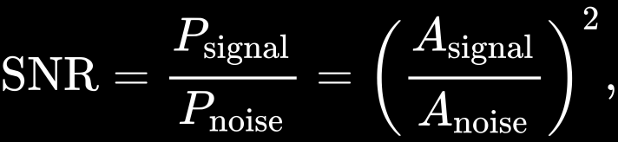
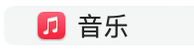

SNR measurement
where A is root mean square (RMS) amplitude

Slide 11
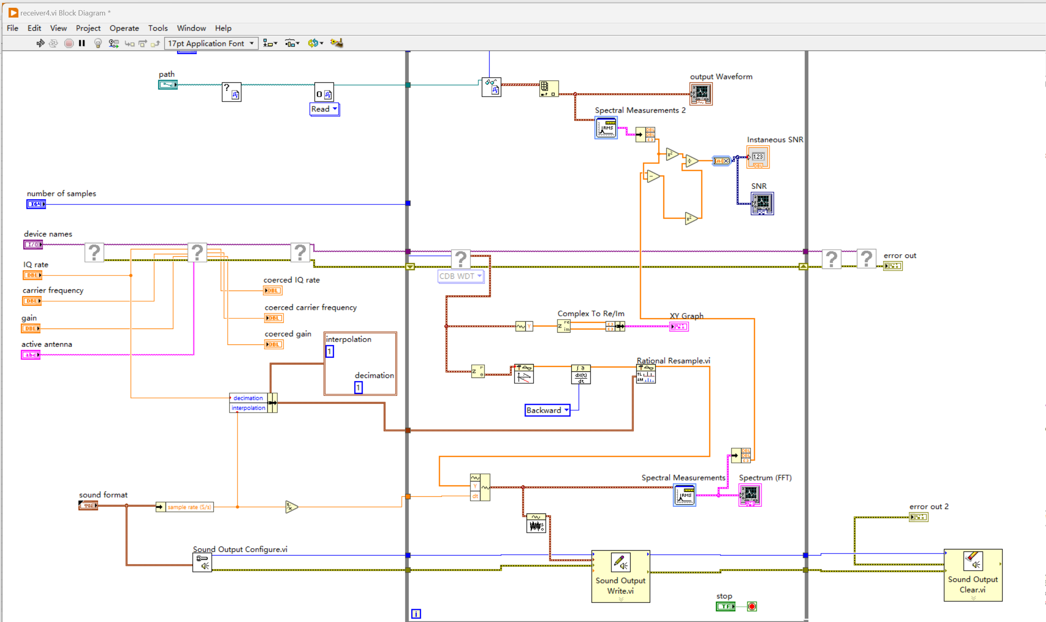
SNR measurement

Slide 12
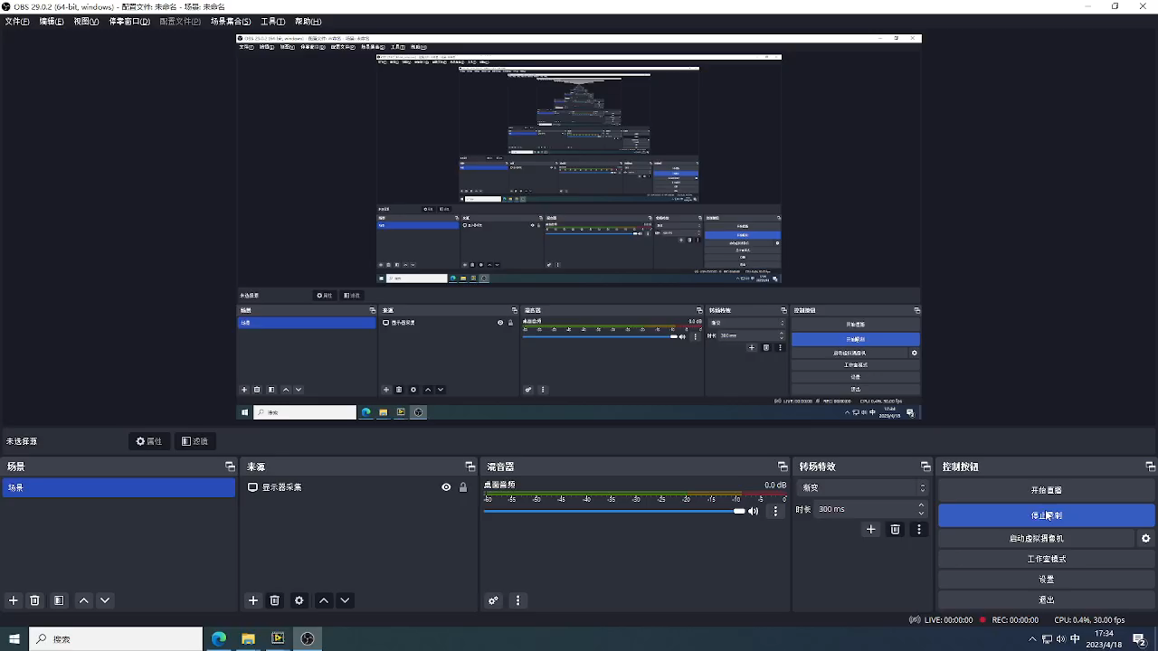
SNR measurement

Slide 13
Experience
Hardware
Interference
Operating Cluster
More to learn later

